Slide 1
Chapter 6: Data Preparation and Variable Transformations

Slide 2
Contents
Introduction to Data Prep
The Manipulate Palette
Data Transformations
Scenario
Append
Aggregate
Remove Duplicates
Join
Filter
Filtering Join
Sort, Rank, Lag
Variable Transformations

Slide 3
Introduction to Data Preparation
Data Preparation: taking the data that you are stuck with and making the best of it
Often takes a large amount of time – even up to 80% of project time!
Many data operations are performed before producing the final table(s) to be used at the modelling stage. Final table(s) known as “modelling view”
Creating the modelling view often requires many operations, including:
Appending
Aggregation (rollup)
Deduplicating
Filtering
Joining
Creating Transformations
Model iterations may require further data/variable transformations
Notes:
The majority of our any modeling project is on data prep. And we all know as we discussed in CRISP-DM that there is a cycle between data preparation and modeling. So you do data prep and as you build your model you realize that there are other things you want to do so you go back to update mining view and do some modification and change your model.
And there are different types of data preparation operation that you use to get to the final mining view. Some of the common one are Merging data, joining data on a field, Appending few datasets, removing duplicates, It’s useful field in data exploration step when you want to see if you’ve done any mistakes. And rolling up or aggregation. Like aggregating transactional data.
And of course there are generic data transformation like log transformation, interaction terms, or setting rules for dealing with missing values, …

Slide 4
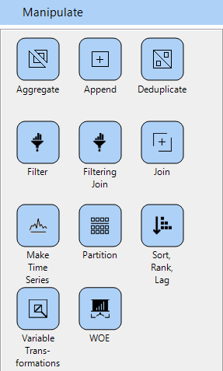
The Manipulate Palette
In this chapter we will focus on the following nodes:
Aggregate
Append
Deduplicate
Filter
Filtering Join
Join
Sort, Rank, Lag
Variable Transformations
Binning
Substitute Missing Values
Transform multiple fields
Weight

Slide 5
Dataset Transformations – The Scenario
Imagine the following scenario:
A business keeps records of customer transactions - complied weekly
There is interest in enriching this transactional data with demographics data
This could be used to build a predictive model to help make marketing decisions
Customer demographics file purchased from a 3rd party vendor
What are the necessary steps to build a modelling view?

Slide 6
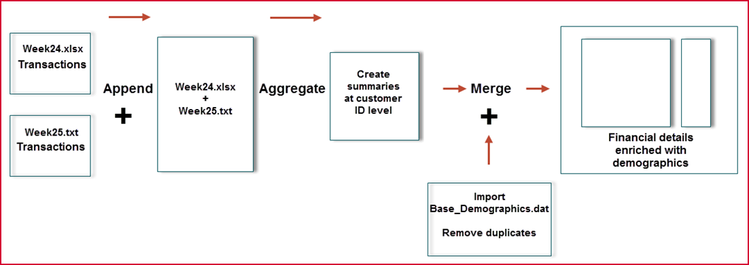
Dataset Transformations – The Scenario
A business keeps records of customer transactions - complied weekly
There is interest in enriching this transactional data with demographics data
This could be used to build a predictive model to help make marketing decisions
Customer demographics file purchased from a 3rd party vendor

Slide 7
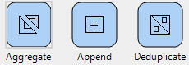
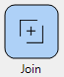
Dataset Operations
We will investigate the following functions for the scenario
Append
Aggregate
De-Duplicate
Join
These operations are at the “dataset level”
One or more datasets are used as inputs, and one dataset is generated as the output
Number of records in your dataset changes
Set of fields in your dataset may also change

Slide 8
Append Datasets
Bring together all records from multiple datasets into a single dataset
Datasets usually contain the same information (or at least close to it)
Think of it like stacking 2 datasets on top of each other
In Knowledge Studio:
Field order does not matter; fields are connected based on name, not location
Can map fields in case names differ
E.g. Price / Cost
Data types must match
First dataset determines columns in new file

Slide 9
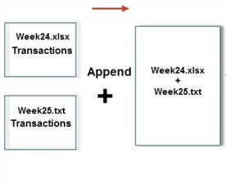
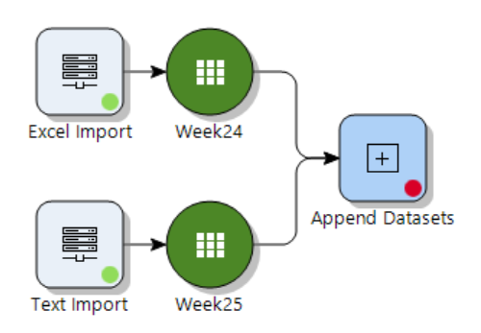
Append Datasets - Workflow
Going back to the scenario, the corresponding workflow to append Week24 and Week25 files would look like this:

Slide 10
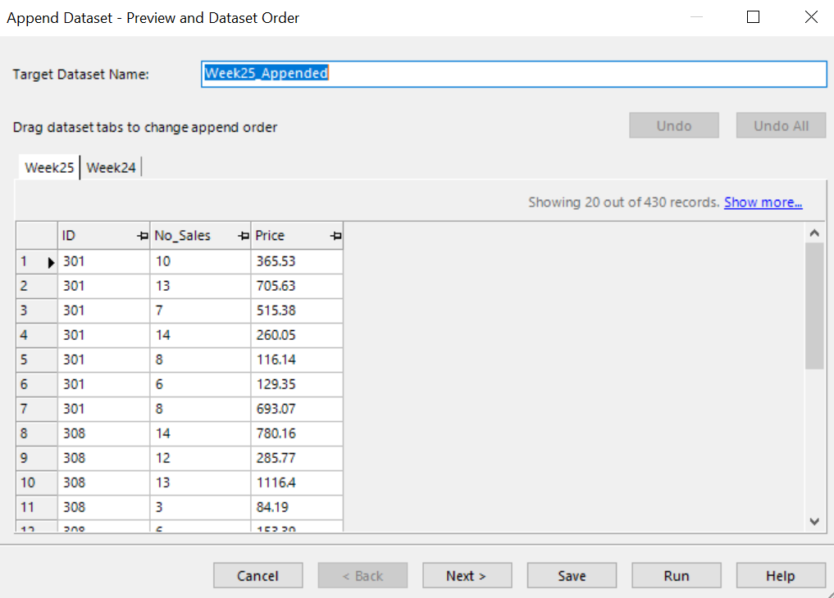
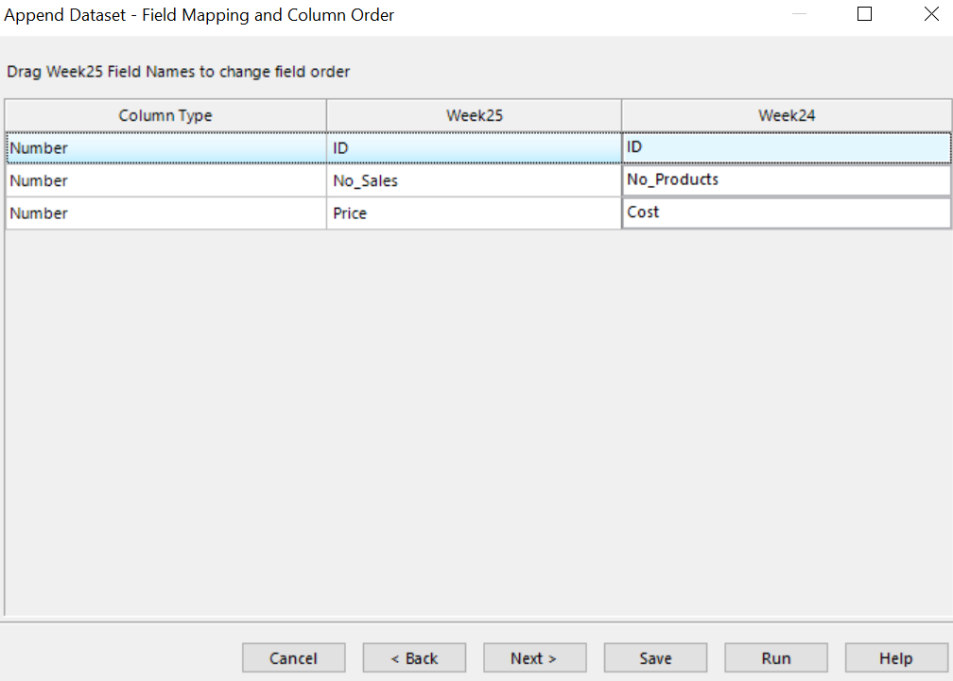
Append Datasets – Wizard Pages 1&2
Preview and Dataset Order wizard: ability to change the append order
Field Mapping and Column Order: ability to change the field mapping
- Data tabs to change the append order
- Drag field names to change field order
Use the dropdown to modify matching fields

Slide 11
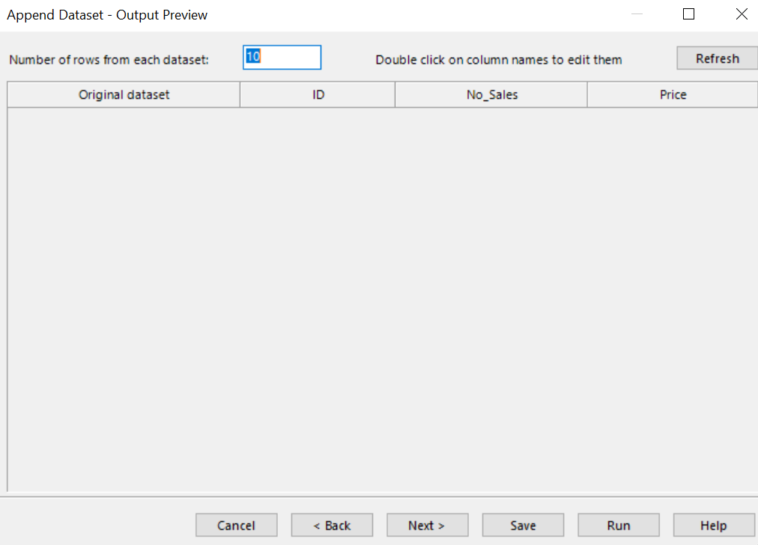
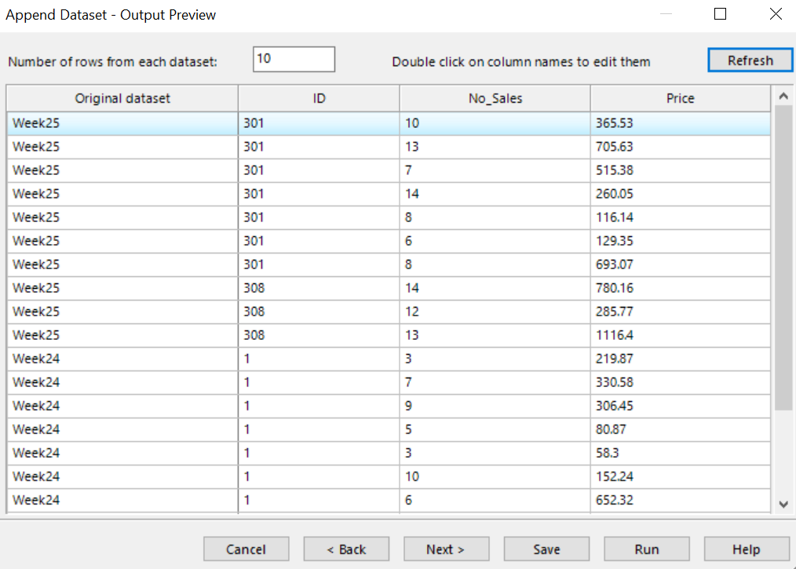
Append Datasets – Wizard Page 3
By clicking Refresh, Output Preview wizard shows a preview of the appended dataset
Ability to edit the column names and the number of rows to preview from each dataset
Once refreshed your chosen data will appear
Select the number of rows from each data set you wish to use, then select refresh
Double click on column names to edit them

Slide 12
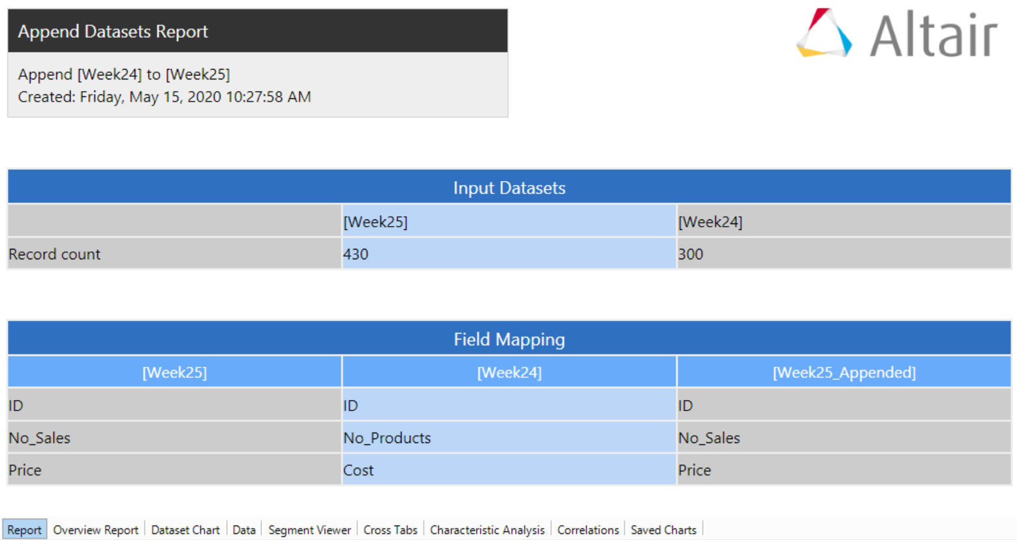
Append Datasets - Output
After selecting the fields to be generated in the final dataset, the Append Datasets Report will show a summary of the field mappings, and record count of the input datasets
Output is a dataset; all the dataset viewer features, plus the report, can be accessed via tabs

Slide 13
Aggregate Dataset
Group records on one or more attributes
Generate summary statistics for other variables based on resulting groups of records
Extremely powerful operation
However, lots of information can be lost as you aggregate data – so be careful!
Example: transactional data from a point-of-sale system
POS data typically has one record for each transaction
To model at the customer level, aggregate data to a single record per customer
Aggregated data would contain information about customers and their transaction behaviour, examples:
Total number of transactions
Total amount purchased
Average purchase size per customer
etc.

Slide 14
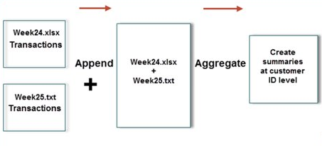
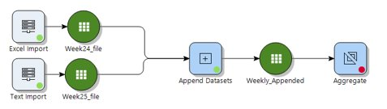
Aggregate Dataset
Going back to the scenario, the corresponding workflow to aggregate Weekly_Appended dataset looks like this:

Slide 15
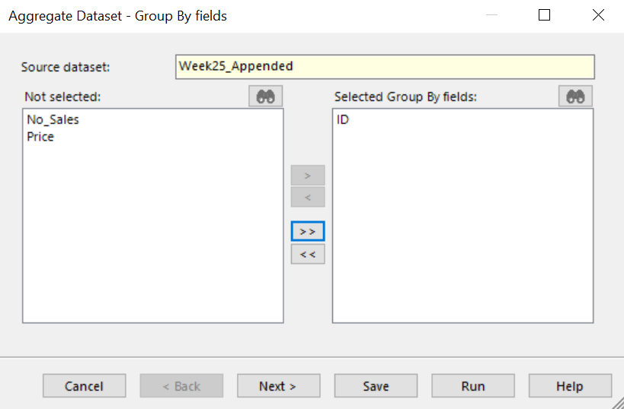
Aggregate Dataset – Wizard Page 1
Group By Fields wizard allows you to specify the Group by field for the aggregation to be performed
Group by field
Notes:
Group by: field which the aggregation will be grouped by – so for example, records with the same customer ID will need to be aggregated

Slide 16
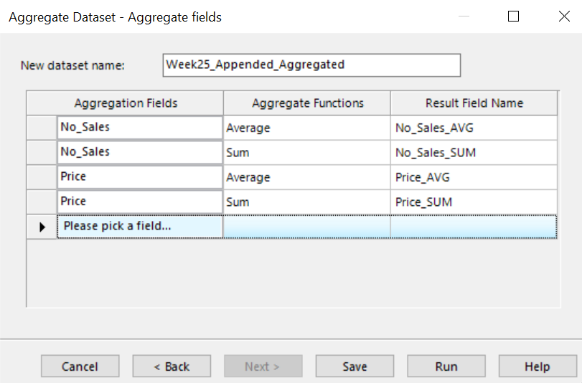
Aggregate Dataset – Wizard Page 2
Aggregate fields wizard allows you to specify the Aggregation Fields and corresponding Aggregate Functions
Able to edit Result Field Name
Can use the same aggregation field multiple times
Edit
Selecting Aggregation Fields and Functions

Slide 17
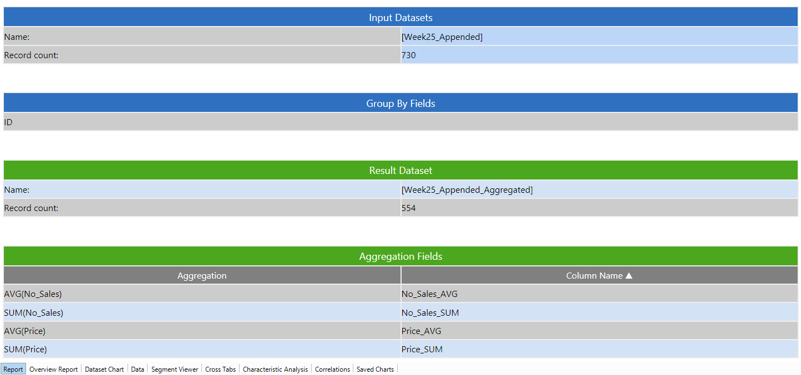
Aggregate Dataset - Results
The Aggregate Datasets Report shows a record count of input and result datasets, group by fields and the aggregation fields
Output is a dataset; all the dataset viewer features, plus the report, can be accessed via tabs
Output Dataset
Aggregate Datasets Report

Slide 18
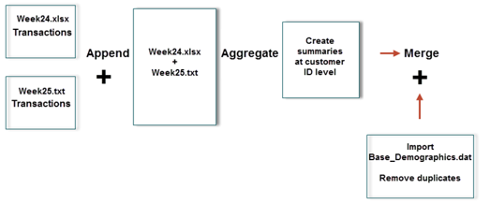
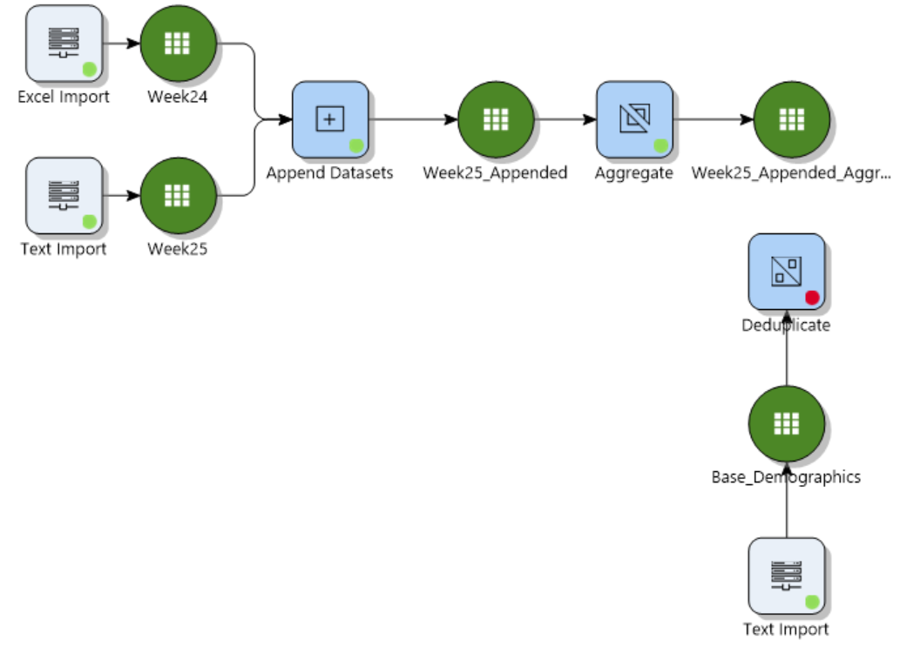
Removing Duplicates
Removing duplicates in Knowledge Studio involves removing records which are exact duplicates of each other
The file we will be working with here is Base_Demographics file which records that are exact duplicates; those would need to be removed before proceeding with the analysis
Going back to the scenario, the corresponding workflow looks like this:

Slide 19
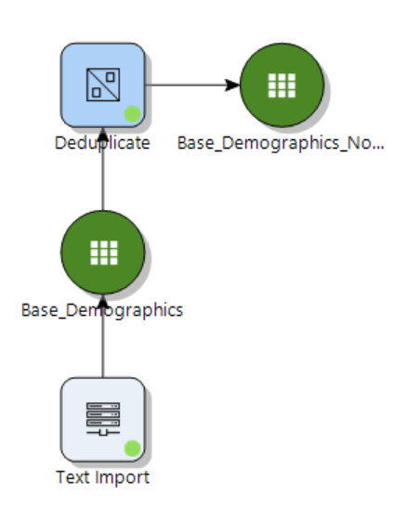
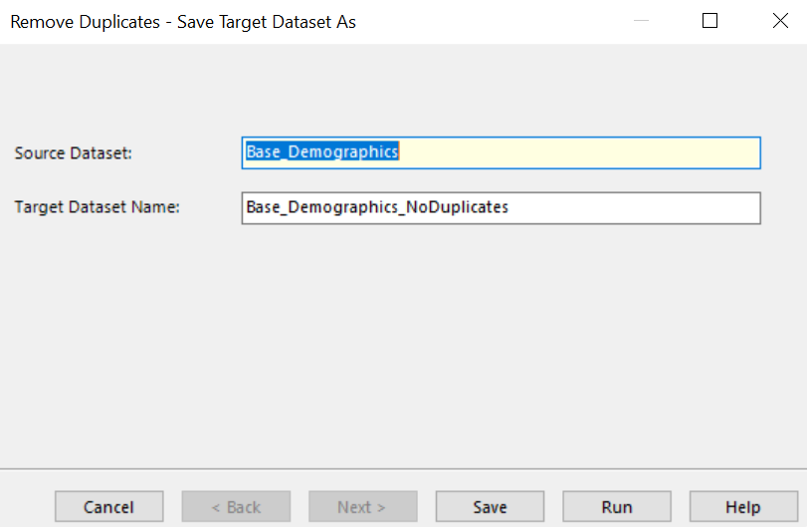
Removing Duplicates - Wizard
The wizard is easy to use
Only setting is the name of the output dataset
Clicking Run generates a deduplicated dataset

Slide 20
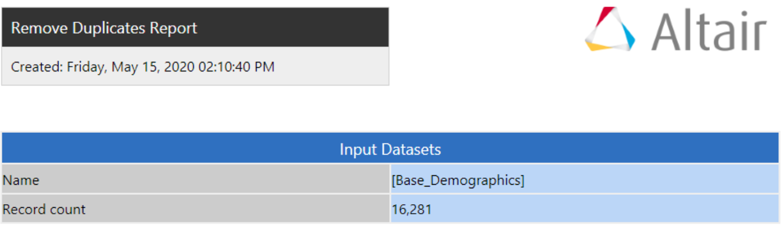
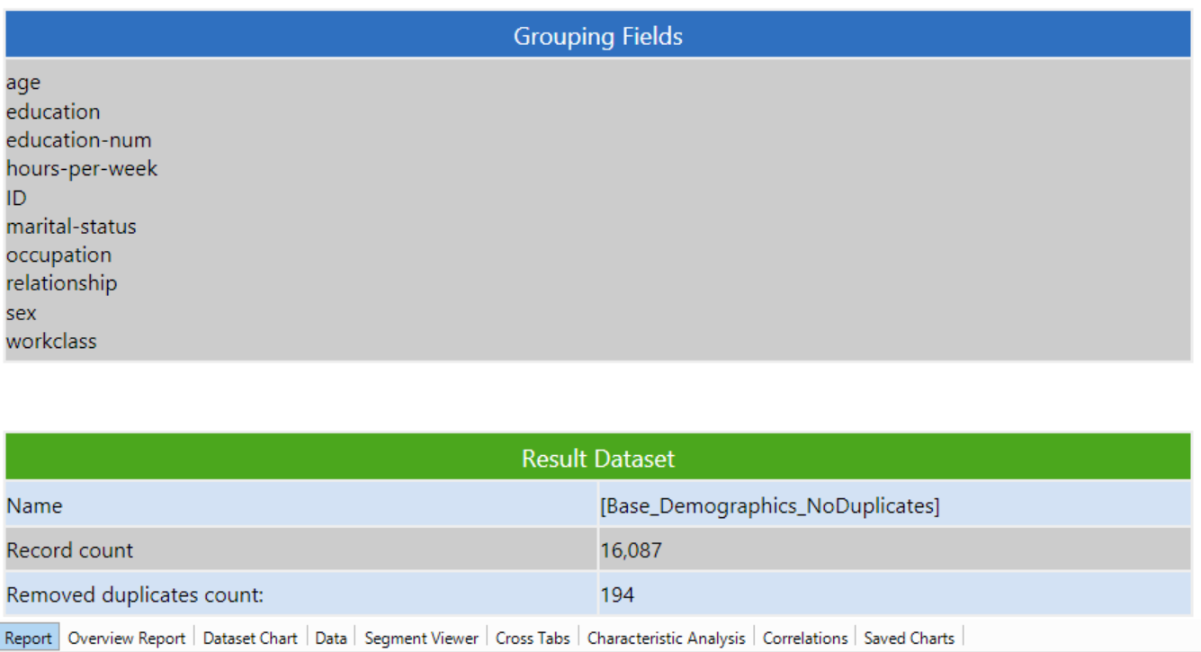
Remove Duplicates - Output
The Remove Duplicates Report shows record count of input and result datasets and the number of removed duplicate records
Output is a dataset; all the dataset viewer features, plus the report, can be accessed via tabs

Slide 21
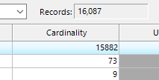
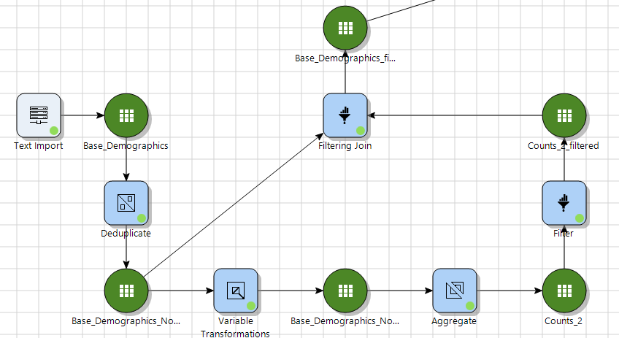
Remove Duplicates – Problem Solved?
Checking the Overview Report from the deduplicated dataset shows that the cardinality of the ID field still doesn't match the number of records
This means that there are some cases of multiple records with the same ID, but other information differs
This certainly calls for some further investigation
We can use Knowledge Studio to find and investigate the missing records, then take action (e.g. filter them out)

Slide 22
Remove Duplicates – Solve New Problem
Steps to single out these records:
Use the variable transformations node to create a second ID column (used in aggregation)
Aggregate the data, grouping by ID and counting the number of IDs
Use a Filter to only keep IDs which appear more than once in the original dataset
Use a filtering join (on ID) with the original dataset to either:
Keep all the records with IDs appearing multiple times (for investigation)
Remove all the records with IDs appearing multiple times (to proceed cleanly)

Slide 23
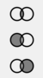
Join Datasets
Joining datasets is a task that involves taking two separate datasets with different information, and making a single dataset with all the information
Only makes sense if you have a column (or set of columns) to match records between the datasets
Often called "key" field(s)
If the key field(s) don't uniquely identify records, problems can arise
In Knowledge Studio:
Can only join 2 datasets at a time, and can only have 1 key field
There are 3 types of joins:
Inner join: retain only records that exist in both datasets
Left join: retain all records from left dataset and matching records from right dataset
Right join: retain all records from right dataset and matching records from left dataset

Slide 24
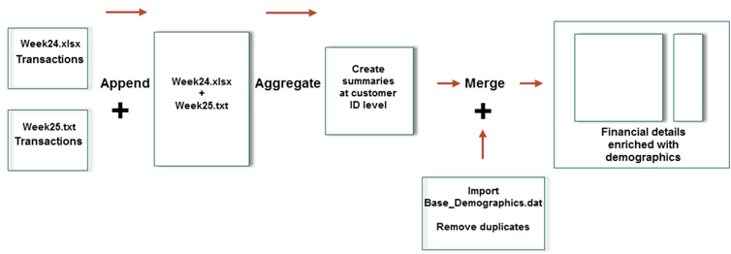
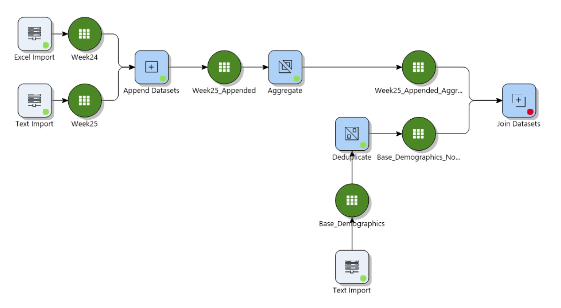
Join Datasets
Going back to the scenario, the next step is to join the deduplicated dataset and the aggregated dataset as shown in the workflow to the right
The final dataset will be an augmented dataset with both transactional and demographic information

Slide 25
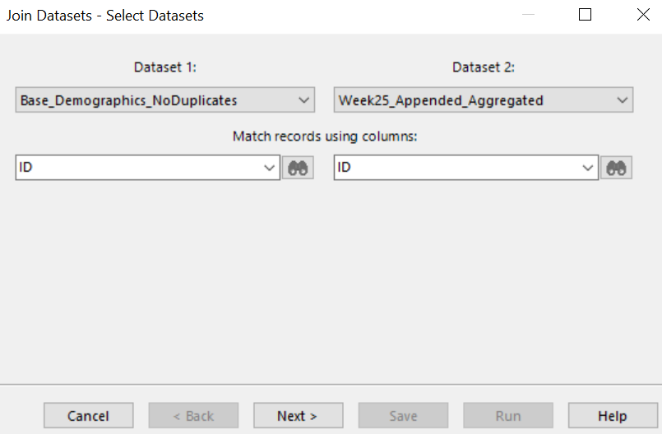
Join Datasets – Wizard Page 1
In the Select Datasets wizard page, select the column for matching records
Have the option to specify which dataset is dataset 1 and dataset 2 from corresponding drop down menus
Select the columns for matching records

Slide 26
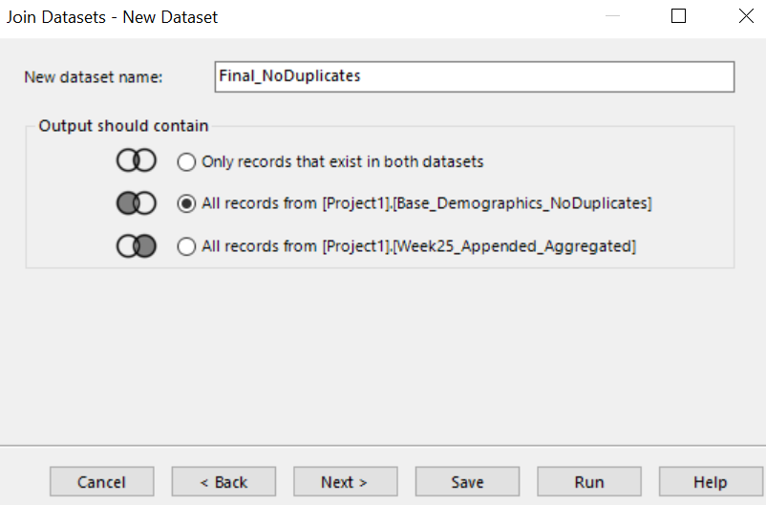
Join Datasets – Wizard Page 2
Specify the dataset name in the New dataset name section and choose the join type
Modify final dataset name
Left Join – keep all records from demographics data and augment it with transactional summarized data
Inner Join
Right Join

Slide 27
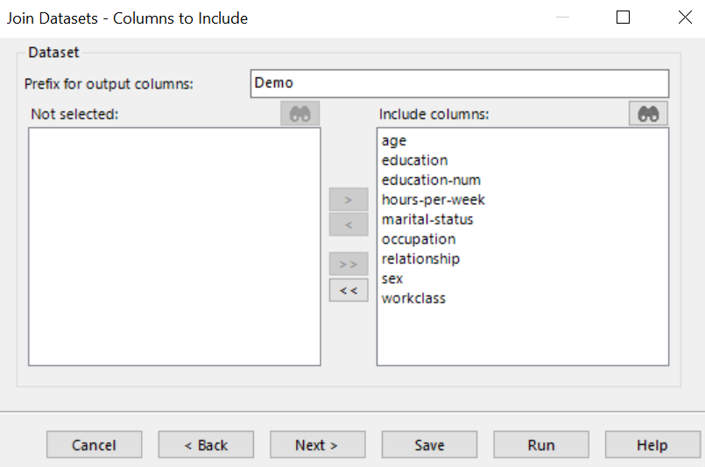
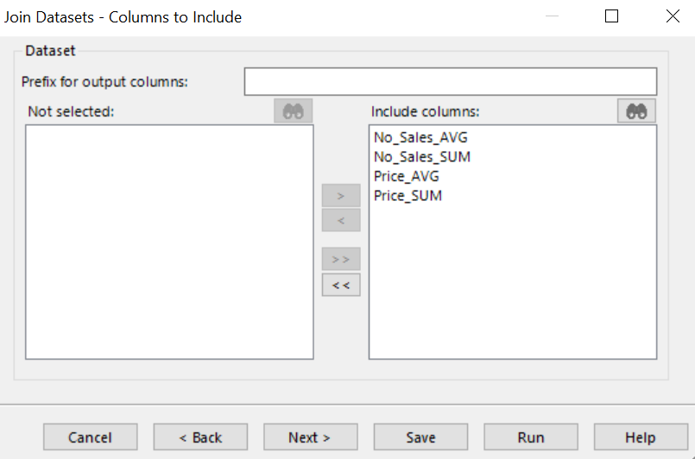
Join Datasets – Wizard Pages 3 and 4
In the Columns to Include wizard pages, you can select which columns to include in the final dataset
Have the option to specify a prefix for the output columns. This can be helpful if you want to indicate the source where variables came from, and necessary if some of the columns have the same name.
Also have the option to leave it blank.
Customize
Include Columns

Slide 28
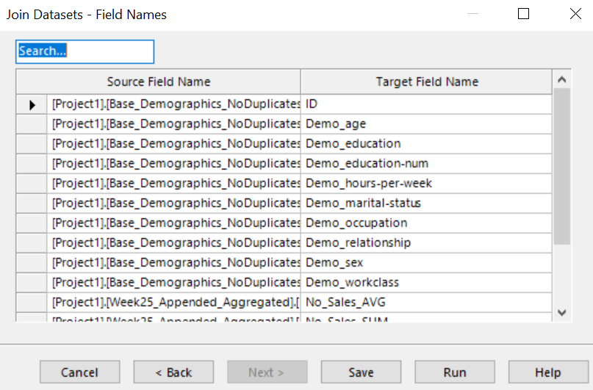
Join Datasets – Wizard Page 5
The last wizard page is the Fields Names and it allows you to rename and search for variables
Note: users will get a warning and be prevented from proceeding if any two columns have the same name
Search for a variable
Rename

Slide 29
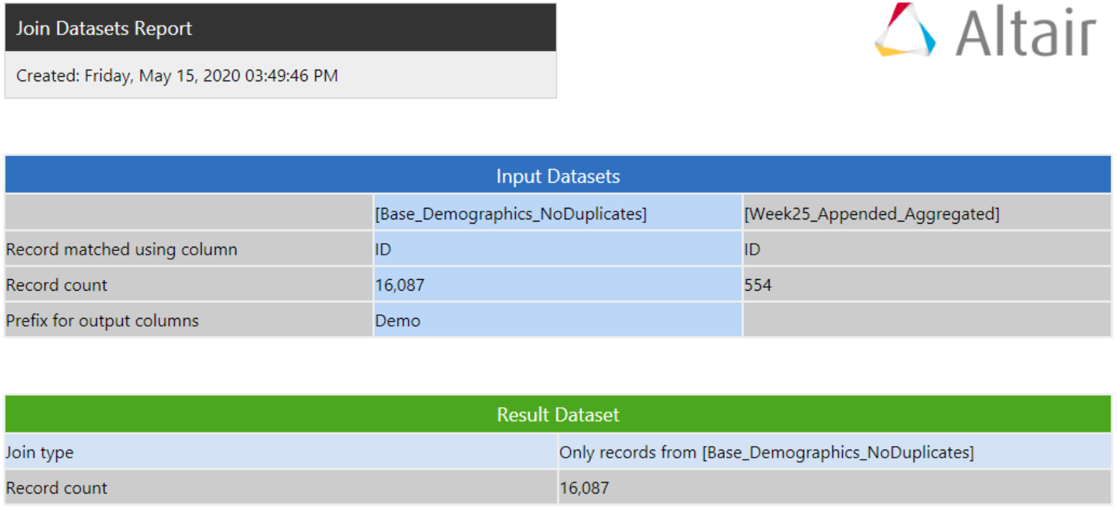
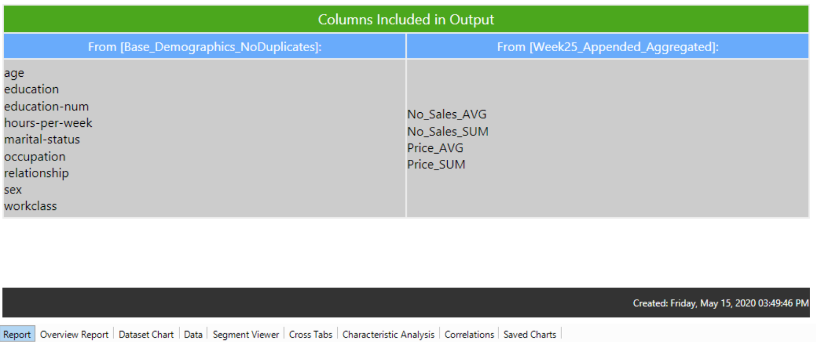
Join Datasets - Output
The Join Datasets Report shows record count of input and result datasets, record matching column and the columns included in the final dataset
Output is a dataset; all the dataset viewer features, plus the report, can be accessed via tabs
Record count of input datasets
Output record count

Slide 30
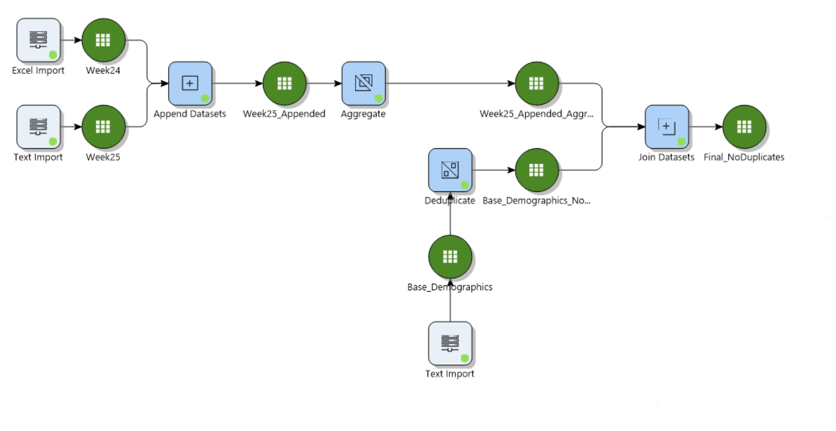
Scenario Conclusion
Tying everything together, we were able to utilize Knowledge Studio to append customer transactions that are compiled weekly, join them to demographic data, and build an enriched dataset
Ideally, this dataset will be used for modelling purposes
The rest of this chapter will focus on other types of data transformations

Slide 31
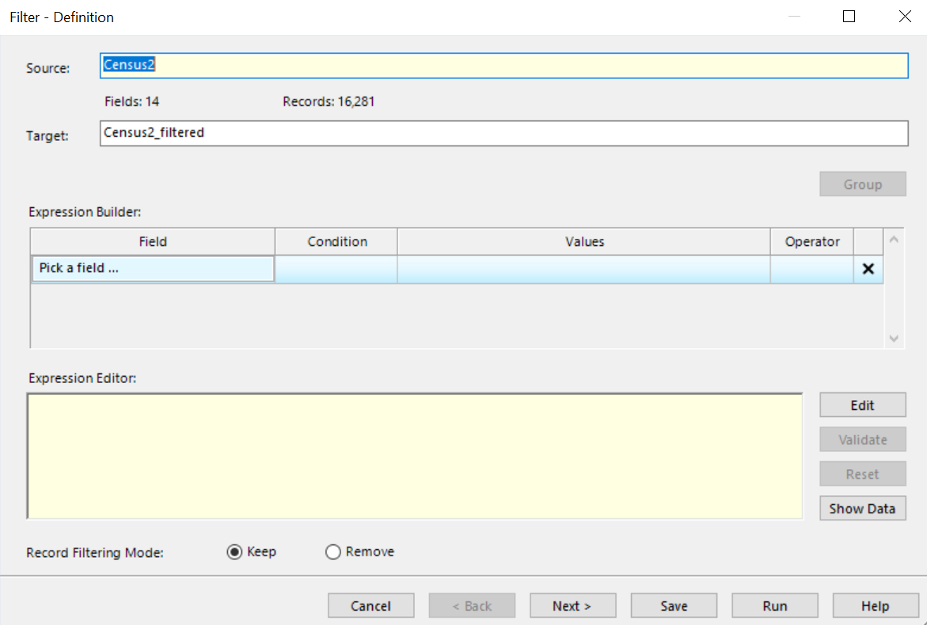
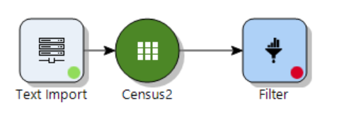
Filter
Filtering is another data manipulation technique that is often performed to select or remove records satisfying user-defined conditions
Filter node in Studio will generate a new dataset on the workflow (e.g. it won't change the existing dataset)

Slide 32
Filter
See the source dataset along with number of fields and records
Set target dataset name
Specify the filtering conditions to be met from the Expression Builder
Users also have the option to edit the conditions manually using the Expression Editor
Select whether to keep or remove records meeting the conditions from the Record Filtering Mode button
Modify
Custom Expression Editor
Keep or remove records based on filtering criteria specified

Slide 33
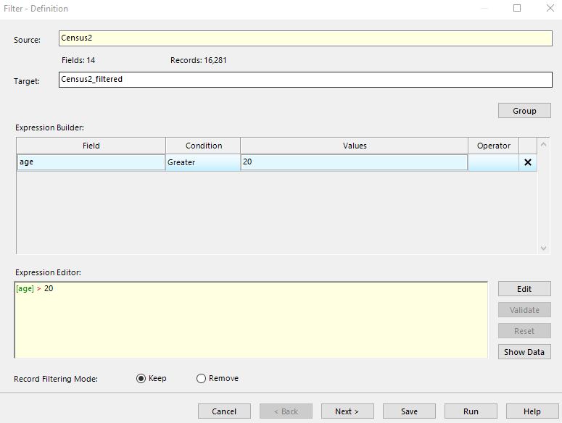
Filter – Expression builder
Expression Builder allows users to specify their filtering conditions
From the drop-down menu, select the field to filter on
Different conditions are applicable for different field types
Once conditions are selected from Expression Builder, the same expression appears in Expression Editor
Able to edit the expressions there
Condition: age > 20

Slide 34
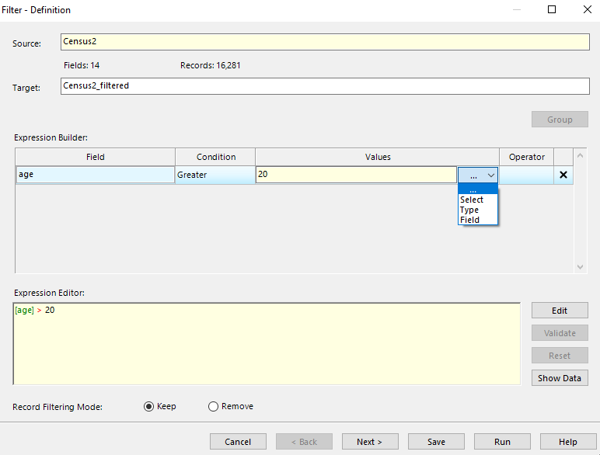
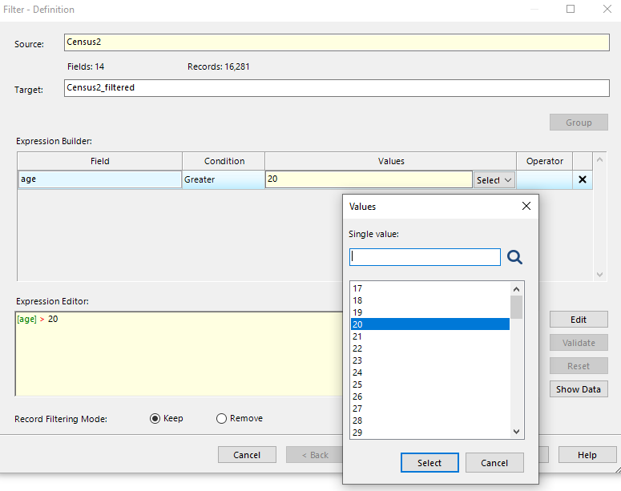
Filter
To specify the values for the condition, choose one of the three available options: Select, Type, and Field
Select: choose from the list of all values of the variable
Type: enter a custom value manually
Field: select another field that the selected one should be compared to. If Field is [age], and Values is specified to [capital-gain] then condition to be met is [age]>[capital-gain]
Option to include more conditions from the Operator column based on AND / OR criteria
Notes:
Explanation of AND/OR - (AND / OR) supposed to combine the current and the next condition. Once the Operator is selected, a new empty row will be added automatically to get the input for the next condition. Add more conditions if required.
AND – filtering must satisfy all the conditions
OR – filtering must satisfy either of the conditions

Slide 35
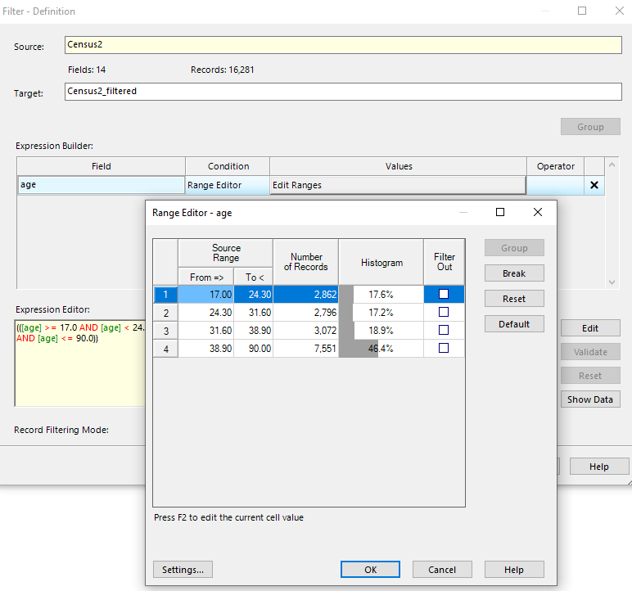
Filter – Range Editor
Range Editor is a special condition which has a pop-up helper
Helper allows user to define specific ranges in a numeric column, see a histogram on the spot, and apply the filter, or not, to each range individually (via the Filter Out column)
Range Editor Conditioner
Filter Out

Slide 36
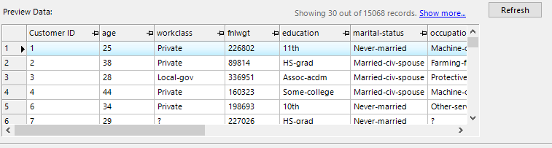
Filter – Show data
Show Data feature allows users to see a preview of the filtered data and see the resulting row count
Preview Data shows sample rows of the filtered data
Once satisfied with the conditions, click Run and the filtered dataset will appear on the workflow
See filtered data
Preview sample data after clicking Refresh
Refresh

Slide 37
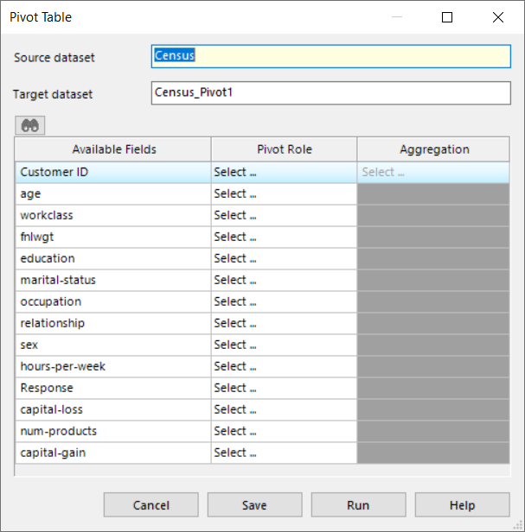
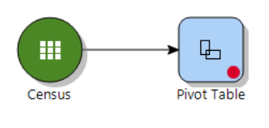
Pivot Table
Pivot is another data manipulation technique to create a pivot table out of the original data
This node will generate a new dataset on the workflow (it won't change the existing dataset)
Modify

Slide 38
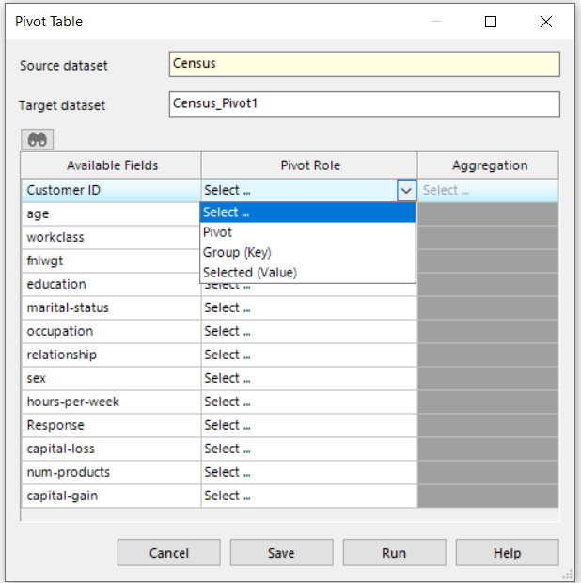
Pivot Table
Select the pivot role for the variables of interest:
Pivot: this will be the pivot variable which will be the columns of the generated output table
Group (Key): this will be the grouping variable which will be the rows of the generated output table
Selected (Value): the aggregation will be done on this variable for the combination of Pivot and Group variables. The user must specify what type of aggregation function to be applied to this variable. Options for aggregation: average, count, min, max, median, mode, std, …,etc.
Users need to select at least one variable for each role (multiple variables can be selected for each role)

Slide 39
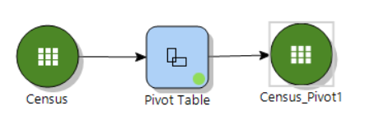
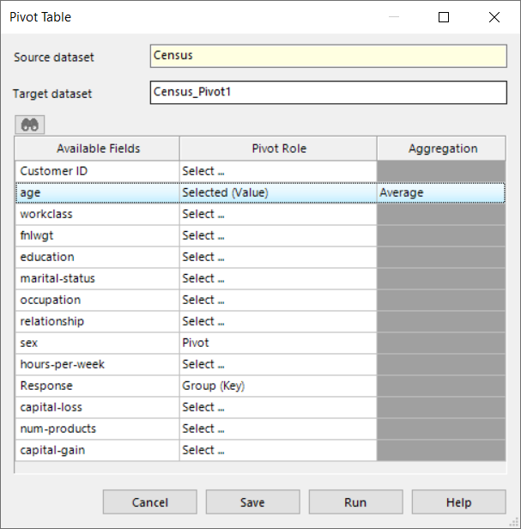
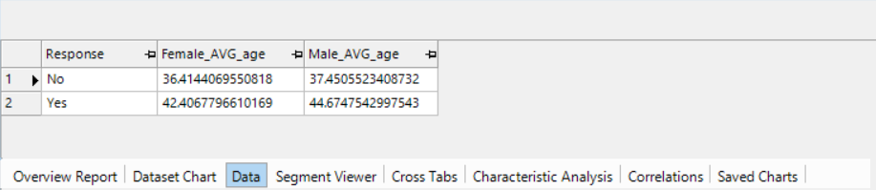
Pivot Table
Example: Average age for combination of Response and Sex variables in Census data
Output Table

Slide 40
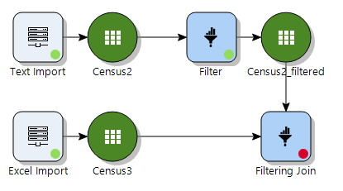
Filtering Join
The filtering join node allows users to filter a dataset based on how it matches up with a different dataset
A key field is needed, and records can be kept or filtered out based on whether they match or do not match the inputs in the second dataset
There are two types of filtering joins:
A "semi-join" is used to keep records that match
An "anti-join" is used to keep records that do not match
The workflow is an extension to the previous exercise to show the Filter node

Slide 41
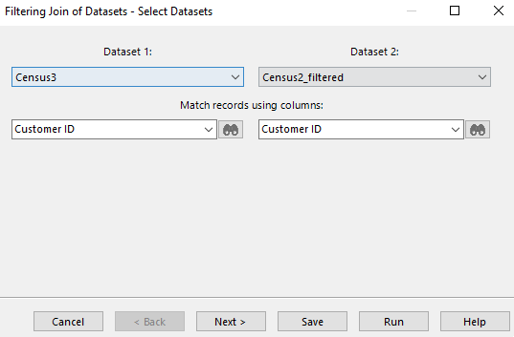
Filtering Join
The Select Datasets wizard page allows users to set "Dataset 1" and "Dataset 2"
This is more important than in some other places (such as the regular join wizard) since fields from Dataset 1 will be kept, but fields from Dataset 2 will be ignored (except the key field)
This is also the wizard page where the key field is chosen
It can have a different name in each dataset, but it should be essentially the same field
Select column for matching filtered datasets

Slide 42

Filtering Join
The next step is to set the dataset name for the newly generated dataset
Will also need to specify the condition of join
Semi-join: keep records from Dataset 1 that match in Dataset 2
Anti-join: keep records Dataset 1 that do not match in Dataset 2
Change dataset name
Select join type

Slide 43

Filtering Join
Once you click Run, a dataset will appear on the canvas
The Filtering Join Report contains record counts for the input datasets and the output dataset, as well as the join type and join field
Output is a dataset; all the dataset viewer features, plus the report, can be accessed via tabs

Slide 44


Sort, Rank, Lag
Sort, Rank, Lag node in the Manipulate palette allows users to sort data, create ranking fields and lagged variables
Group-by ranking fields and lagged variable creation steps in the Sort, Rank, Lag node are optional
Source dataset
Target dataset name

Slide 45


Sort, Rank, Lag
The next wizard enables users to select the variables of choice for sorting
By default, variables are sorted in ascending order and users have the option to select the descending order
All variables can be moved from the Available column to the Selected column to be ranked
Once multiple variables are selected for ranking, they can be moved up or down the list using
Sorting by order
Move selected variables up or down

Slide 46

Sort, Rank, Lag
Sort, Rank, Lag - Group by wizard provides grouping options
The available variables for grouping will be the ones used to do the ranking
To create a ranking field based on the sorted data, select Create Ranking Field
Specify the name for the ranking field and choose whether to create ranking by group or not
As previously stated, group-by ranking fields creation step is optional
Create Ranking Field AGE by group

Slide 47

Sort, Rank, Lag
Any variables that were not used for grouping will be available to create lagged variables
Select the variables to which a lag function is to be applied to create lagged variables
Specify Lag Orders from the four provided options
Option to Handle Missing Values on the generated lagged variables
Select variable for lag function
Lag order
Option to handle missing values

Slide 48

Sort, Rank, Lag
Specify Lag Orders
Specify a lag: creates a single lagged variable. In the example below, we specify 1 lag order
Specify lags up to: creates N lagged variables with lags 1 – N. In the example below, we specify 5 lag orders
Specify multiple lags: creates N number of lags as a comma-separated sequence of positive integers representing the lag values. In the example below, 1, 3, 6.
Specify lag range: specify the range boundaries for the lags. Inputting 1 and 3 creates 3 lagged variables 1, 2, 3.

Slide 49


Variable Transformations
Record level transformations
Dataset Editor (Variable Transformations Node)
Possibly the single most important node in Knowledge Studio
This node is primarily used for creating new variables (via the Expression Editor)
Create new fields
Create multiple fields at a time through Transform Fields
Edit fields
Instantiate variables
Remove variables

Slide 50


Variable Transformations
Clicking on add field from the Dataset Editor opens the expression editor
To access the Expression Editor, choose Add Field
Expression Editor is where transformations happen
Expressions can be typed in manually
Users have ability to validate the code
The Columns, Functions and Operators can also be used to build the expression
Can also use Helpers: wizards to walk you through building common expressions

Slide 51


Variable Transformations - Helper
Users also have option to Add Fields from the Helpers Menu
Different expression types are available for use
Binning is a very common expression type to use to create and combine categories of a variable
Two types of binning are available:
Continuous Binning for continuous variables
Discrete Transform for discrete variables
Sample expression type
Can apply transformation on these variables

Slide 52


Variable Transformations - Binning
Can group, break, reset bins
Selecting the variable Relationship under the Discrete Transform category generates the Range Editor Wizard
Group the categories Husband and Wife to one category
Rows do not have to be contiguous to be grouped
Change the label of the category to Married by highlighting the column under Target Label
Use the Break button to break apart a group to the original categories
Can also Reset the categories to original format
Can change category label
Group Husband and Wife into one category

Slide 53

Variable Transformations – Binning Expression
Once you click Finish, the expression appears in the Expression Editor
This is a CASE statement used to create new categories for the variable
Modify label manually by changing the value in the THEN clause
Can also modify the Field Name
Force data to be instantiated option is available
Selecting this option means the expression that defines the values of the new column will be removed in the new dataset
Change field name
Can modify expression

Slide 54
What does "Force Data To Be Instantiated" mean, and why do I care?
By default, when you create a new field, Knowledge Studio doesn't store all the new values in that field, instead it just stores the calculation to get that field from existing field(s). You can use the Force Data To Be Instantiated option to override this default and store the new values themselves
The default behaviour is efficient in terms of space, and can have some benefits, but also some drawbacks (and can also be used as a clever hack in some places)
Example benefit: If you perform variable transformations during data prep, and then want to score new data, you don't need to perform the same data prep on the scoring data, since Knowledge Studio recognizes the original variables and automatically handles the modifications
Example downside: If you scale data based on the mean of a column, when you try to score new data, Knowledge Studio will try to compute the mean of the scoring column instead of the original column. This is very likely not what you want
Example hack: Knowledge Studio doesn't have an option to rename a field. However, you can copy an existing field, and then delete the original. However, you won't be able to delete the original unless you instantiate the new field

Slide 55


Variable Transformations – Substitute Missing Values
Another method commonly used is dealing with missing values
Like binning, can access substitute missing values from the Helpers Menu
Choose the appropriate treatment for replacing the missing values from the available options in the drop-down menu
In this example, we will replace missing values with the mean
Change the field name of the newly created variable
Variable
Treatment of missing values

Slide 56

Variable Transformations – Preview Data
Once the variable is added, clicking on Show Data in the Dataset Editor shows the three transformed variables we created in the previous slides
Edit Fields to modify the variables transformations performed
Expressions can be exported and imported into different datasets
You can do this directly from an existing dataset, or by saving the expressions to an xml file
Created fields
Show or hide data

Slide 57
Variable Transformations – Remove Fields
Users have the option to Remove the transformed variables or the original variables
Users will be alerted if they try to remove an original field that has transformed field dependencies
This means that the original field and the transformed field will be removed from the output dataset
The output dataset will not contain the variables selected for removal
Remove field

Slide 58


Variable Transformations – Transform Fields
Transforming Fields is an option to do the same variable transformations on multiple variables
Move variables of choice to the selected area
We selected capital-gain and capital-loss
Expression is already populated with [%SelectedField%]
This is a proxy for the variables to transform
Transform multiple variables at once

Slide 59

Variable Transformations - Transform Fields
Our goal here is to obtain the log of the variables capital-gain and capital-loss
Because both variables have values of 0 and because Log(0) is undefined, we add 1 to the expression as follows:
LOG(1+[%SelectedField%])
Use validate button to validate the expression
Can also clear the expression
The derived fields in the dataset will have either a Prefix or Suffix linked to them. In this case, prefix is specified as Expr_
Selected variables
Add expression and validate
Can use functions and operators to create expression

Slide 60

Variable Transformations - Transform Fields
The generated fields will appear in the Dataset Editor
Any of the fields can be removed by checking the boxes in the Remove column
Created fields

Slide 61


Variable Transformation - Weight
We have covered various variable transformation methods that are commonly used while preparing data for modeling
In the next few slides, we will go over the concept of creating Weight variables in Knowledge Studio
From Dataset Editor, click on Add Field, Helpers and choose the Expression type as Weight
Select the variable of choice as "sex"

Slide 62


Variable Transformation - Weight
Three options are available for creating a weighted variable from the Expressions Helpers Wizard:
Weight values
# Records – number of records requested for each value of the variable
Percentage
In this example, we want to create a population where the distribution of Males and Females is equally distributed i.e. 50%-50%
We use the Percentage feature to input the values for both categories

Slide 63

Variable Transformation - Weight
Toggle Weight On/Off
Click on the generated dataset. Once you set the weight, you can easily switch between weighted and unweighted representations in all dataset views using the menu command Edit | Toggle Weight On/Off
By default, any new model created on a weighted dataset inherits its weight
The weight in a dataset and its dependent models can be changed or reset independently
Toggling weight in the dataset Overview Report does not affect dependent models
Set weight

Slide 64

Variable Transformation - Weight
From the list of available tabs, click on Dataset Chart
The dataset chart for the variable Weighted_Var_Sex shows the distribution of the newly created weighted variable
Both categories male and female are equally represented in the dataset

Slide 65
Chapter 6 Exercises (1/2)
Append Datasets
Import these files: FileLeft.xlsx and FileRight.xlsx
Profile both files using Knowledge Studio functionalities
How many rows and fields are in each?
Append the files retain fields from both
Join Datasets
Import these files: FileOne.xls and FileTwo.csv
Explore the files
Is there a common field across files to enable a join?
Join both files retaining all records in FileOne.xls
Remove Duplicates
Import the file Dups.txt
Explore the file, look at number rows and columns
Remove duplicated rows using deduplicate node
How many records left in the de-duplicated result?

Slide 66
Chapter 6 Exercises (2/3)
Aggregate a Dataset
Import the file Census.xlsx
Group by the field Response. Choose some continuous and categorical variables selecting an appropriate aggregate in each
Explore the results
Filter a Dataset
Import the file Census.xlsx
Filter the dataset on the field education to keep all records that have a Masters OR Bachelors
Hint: specify condition “in a list” and the values as Masters OR Bachelors
Show the data within the wizard. How many records are in the filtered dataset?
Filtering Join
Import these files: FileOne.xls and FileTwo.csv
Use the Filtering Join node to join the two datasets on ID
Join both files retaining all records in FileOne.xls that match in FileTwo.csv

Slide 67
Chapter 6 Exercises (2/3)
Sorting, Ranking and Creating Lag Variables
Import the file Census.txt
Use the sort, rank, lag node to rank the dataset by age in descending order
In the same node, create a ranking field by group based on age. Rename the variable to Age_Ranking
Create a lagged variable based on capital-gain. Specify a lag of 1 as the lag order
Explore the results
Define Special Values for the variable hours-per-week
Create a new Description Field identifying records with a value of 99. Leave the Description field default value as null
Additionally, add a replacement field for hours-per-week where the value 99 is replaced with null
Enter 'Special missing value' as the Description field entry
Run the node and explore the results. What proportion of records have a value of 99 for the variable hours-per-week?

Slide 68
Chapter 6 Exercises (2/3)
Variable Transformations
Use the Helper functions to create some new fields
Bin the continuous field capital_gain into three Equal Width bins
Create a weight variable based on the field sex. Ensure that all categories of sex are equally represented when the weight is applied

